Slide 1

Zoom 101

Slide 2
What we will cover today:
Turning on and off your camera/microphone
Reactions, raising hands
Changing your view – speaker view or gallery view
Joining breakout rooms
Using the chat
Turning on closed captioning
updating your zoom before April 16th

Slide 3
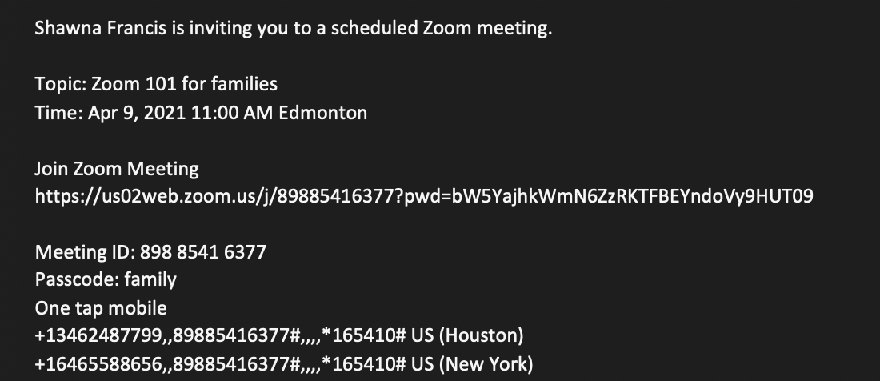
Where to find the passcode
Click this Link
OR
Type in this code and
find the passcode
underneath

Slide 4
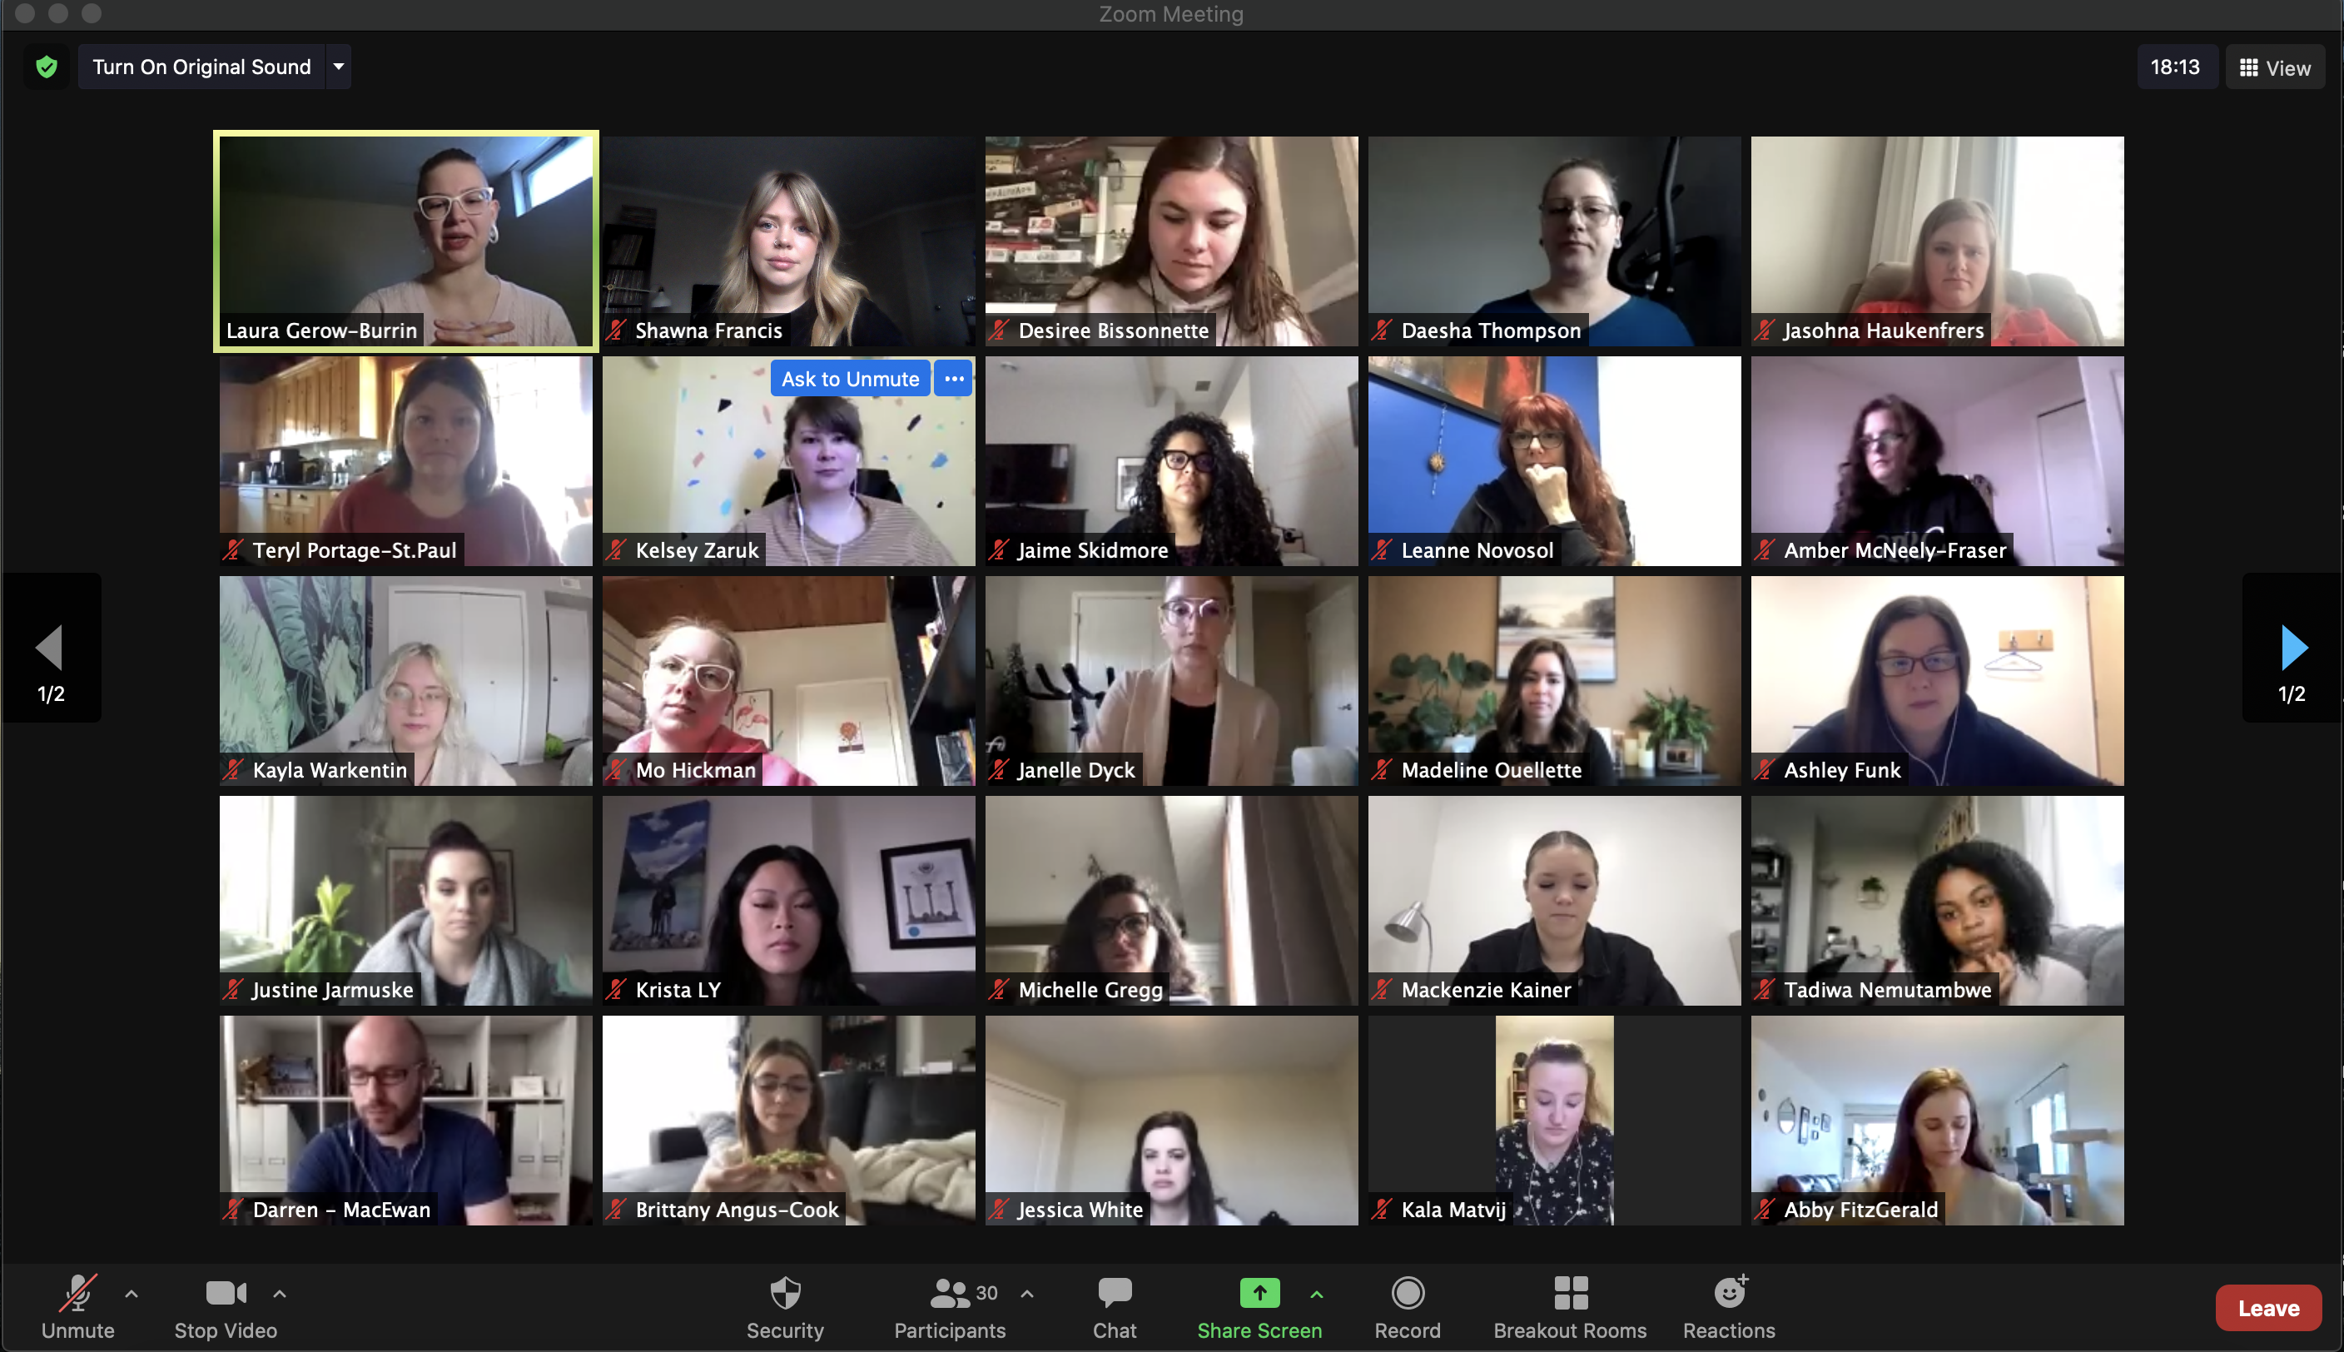
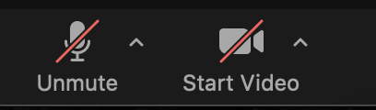
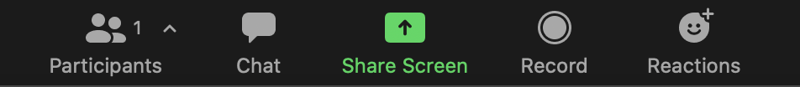

Slide 5
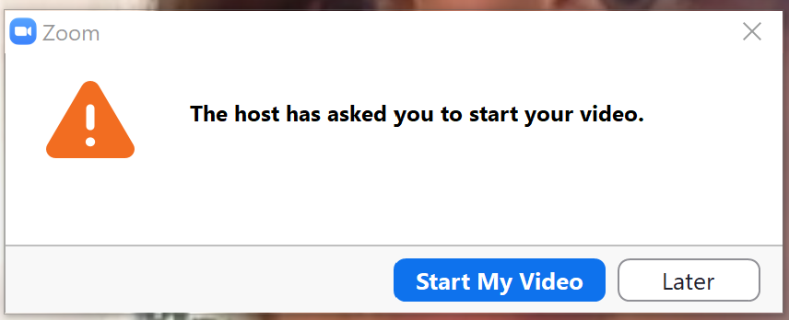
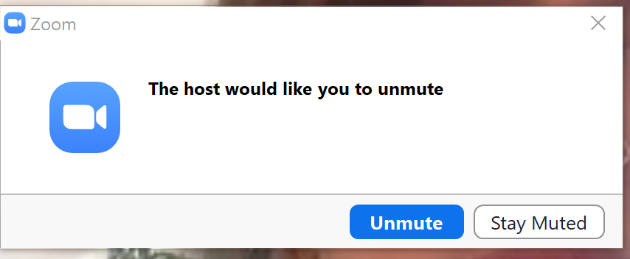

Slide 6
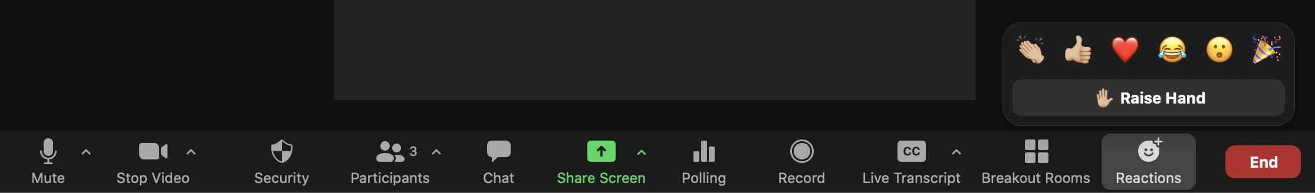
Using reactions or raising your hand

Slide 7
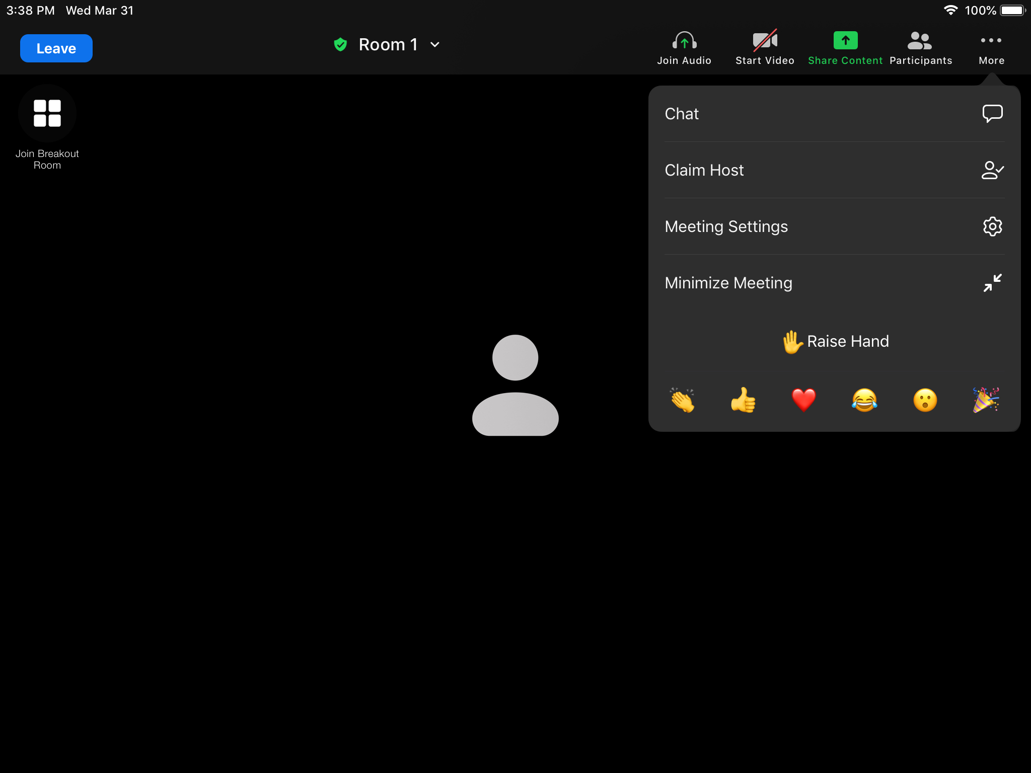
Using reactions or raising your hand – from an ipad or phone

Slide 8
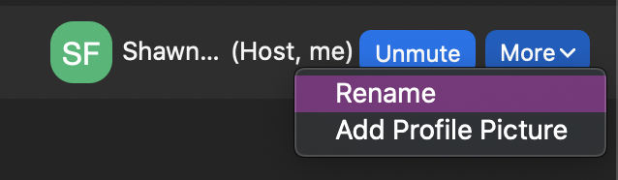
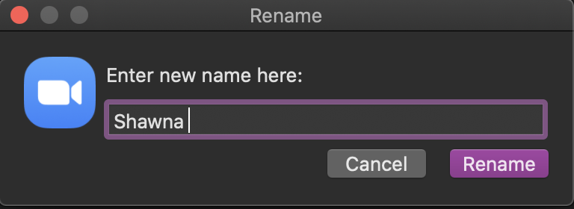
Rename your screen name

Slide 9
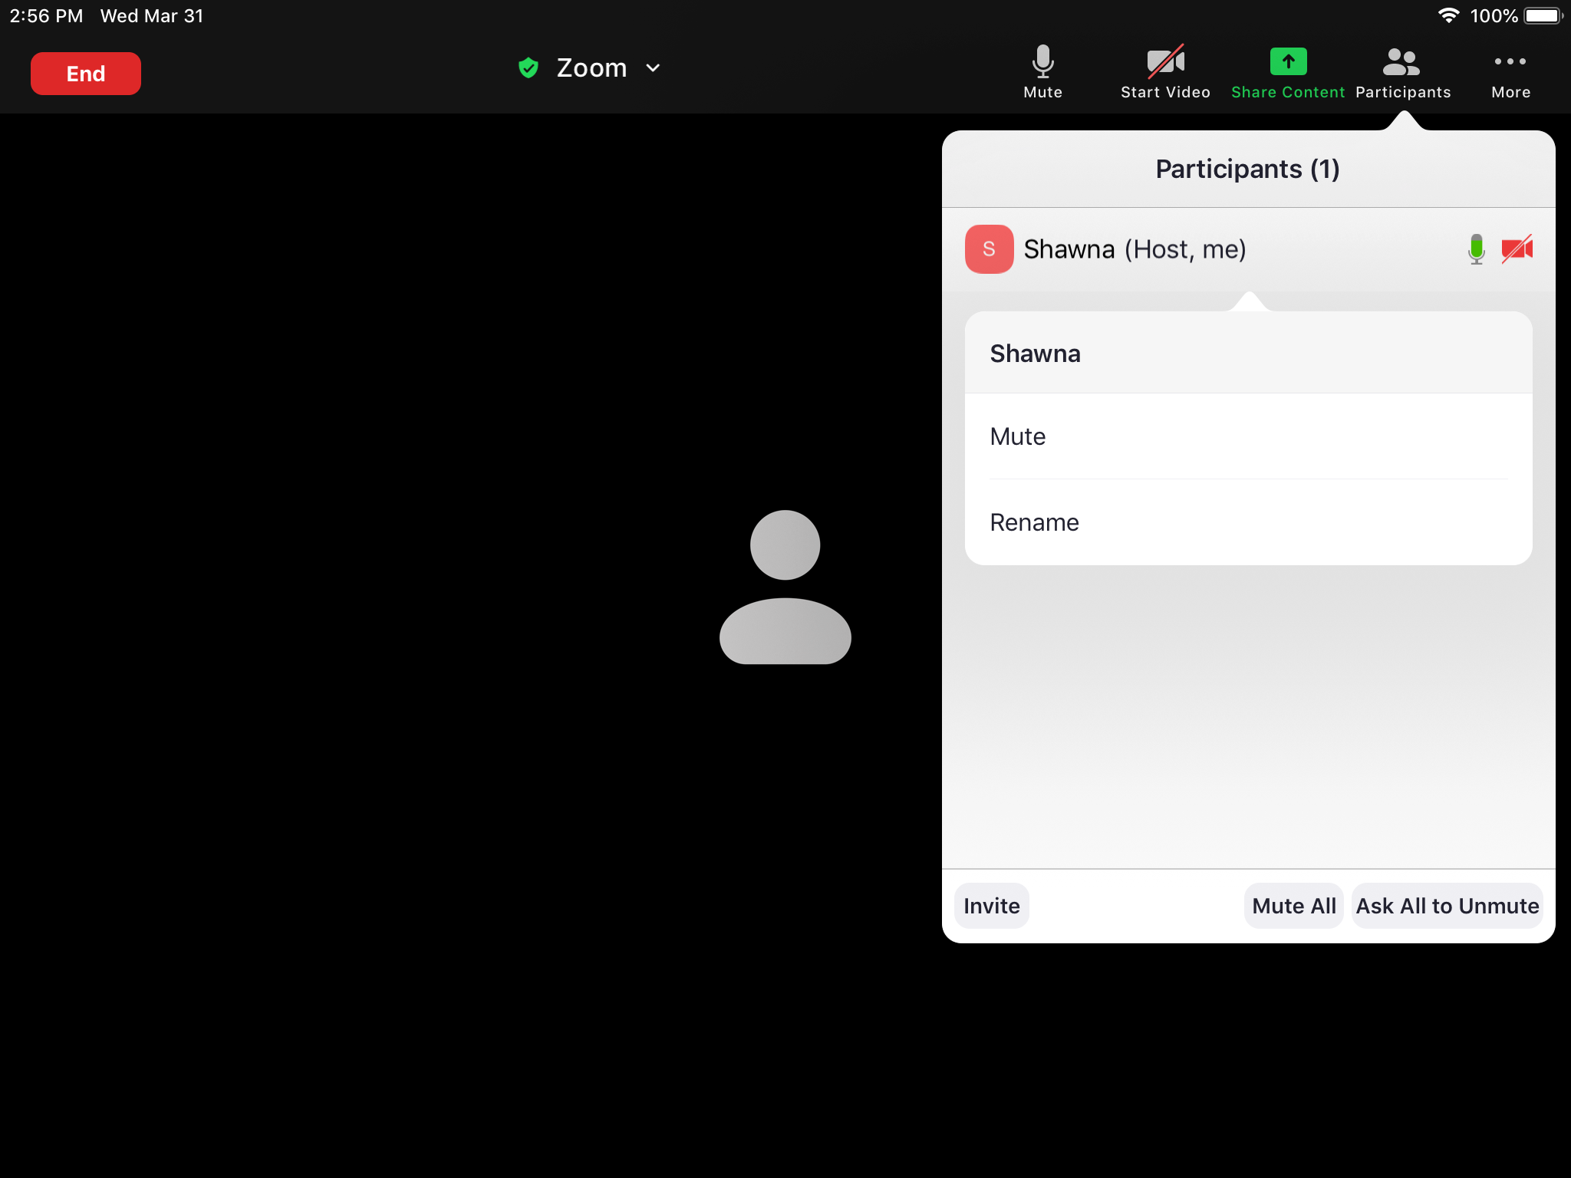
Rename your screen name on an iPad or cell phone

Slide 10
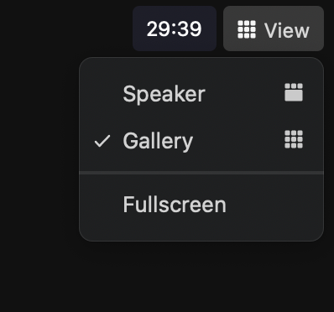
Changing your view

Slide 11
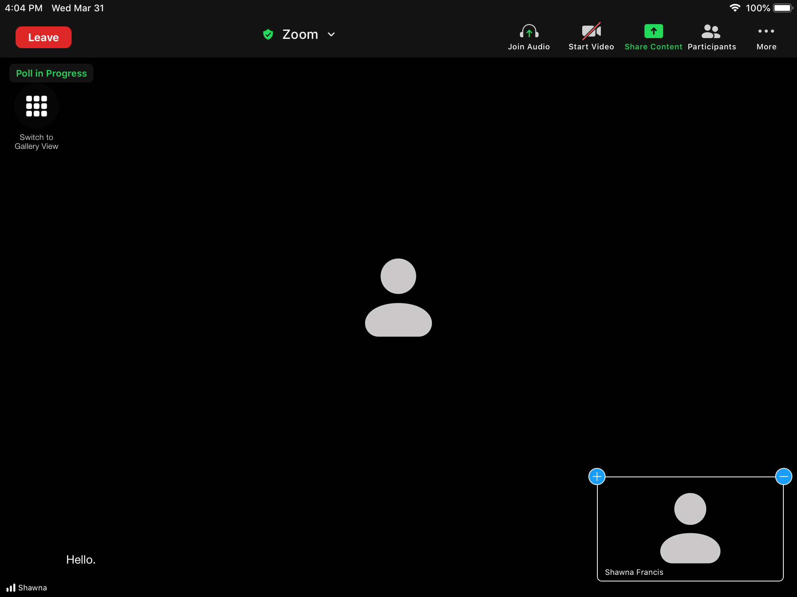
Changing your view from and ipad or phone

Slide 12
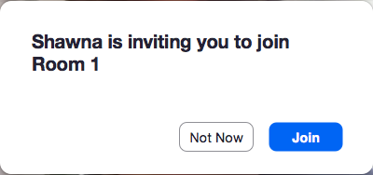
Joining breakout rooms

Slide 13
Using the chat
Notes:
Note: Positioning of the chat- you can place this beside the video when on computer, but it will cover the meeting for mobile users. We will likely enable mod and everyone, but not direct chat.

Slide 14
Using the chat on an ipad or phone

Slide 15
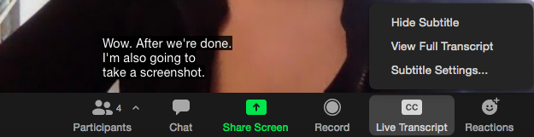
Closed captioning
Notes:
Shawna

Slide 16
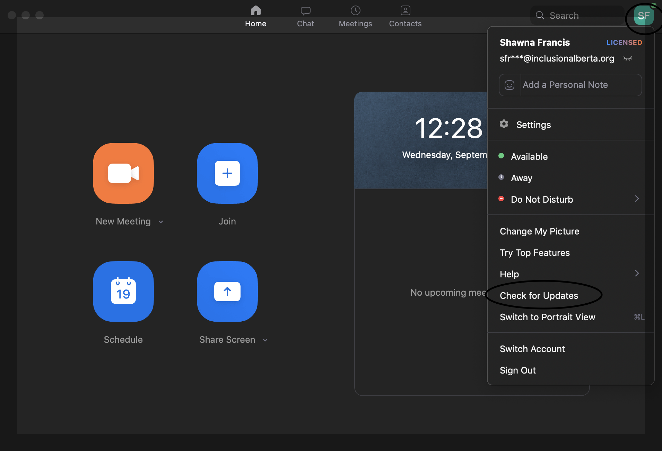
Checking for updates on zoom

